Slide 1
Checkmarx Tutorial
Running Basic Scans

Slide 2
Login Details & URL
Tool Server: 10.0.4.101
Username: checkmarx
Password: Admin@123
Local URL: http://127.0.0.1/CxWebClient/Login.aspx
Network URL: http://10.0.4.101/CxWebClient/Login.aspx

Slide 3
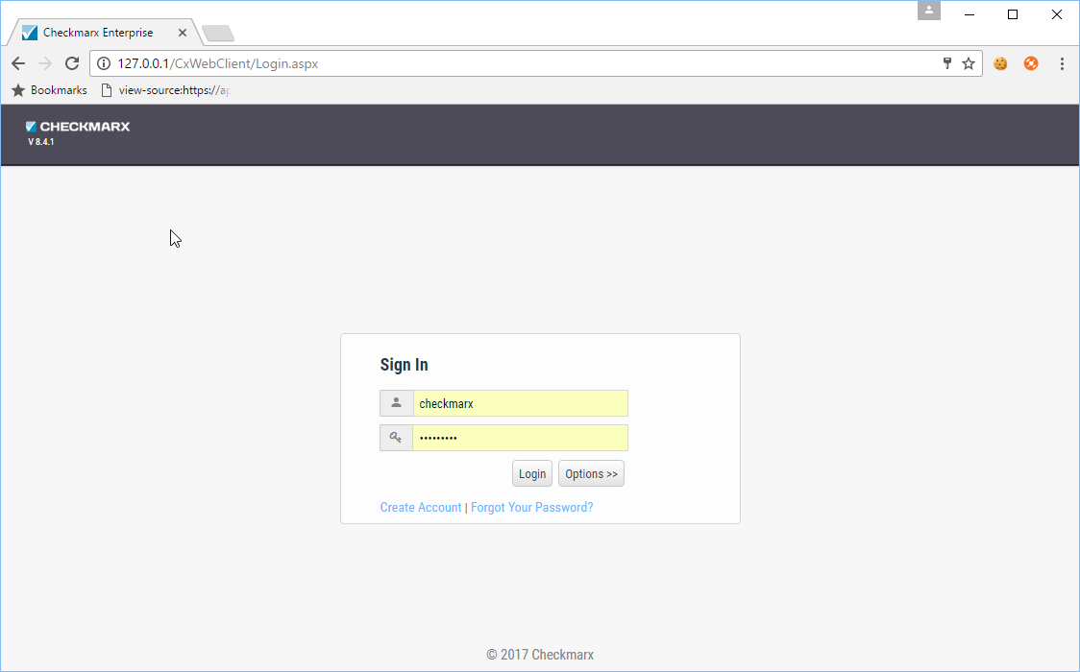
Login with Username and Password

Slide 4
Configuration of Checkmarx for performing a scan

Slide 5
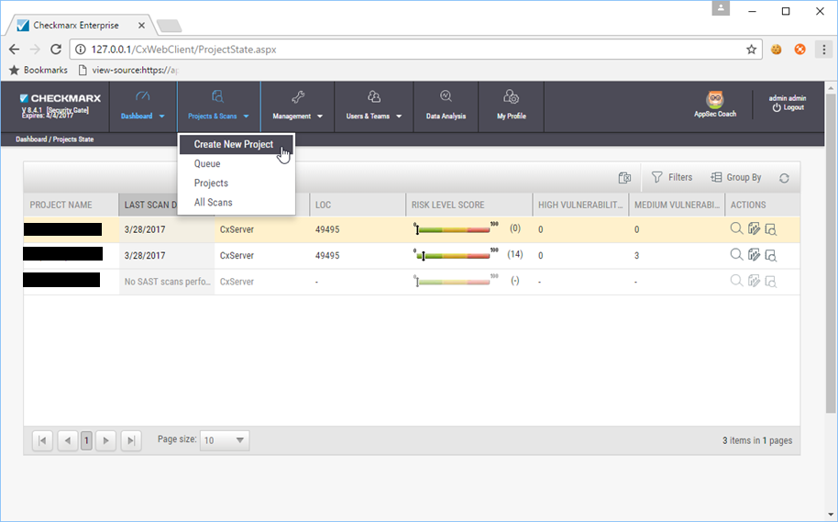
Navigate to Project & Scans > Create New Project

Slide 6
In the “New Project” window > “General” section
Enter respective Project Name with convention <clientname>_<appmame>_<date(dd,mm,yy)>
E.g. ‘BOPA_IOS_03042017’
Select “Checkmarx Default” for the Preset dropdown
Select “Default Configuration” for configuration dropdown
Select “CxServer” for Team dropdown
Click on Next

Slide 7
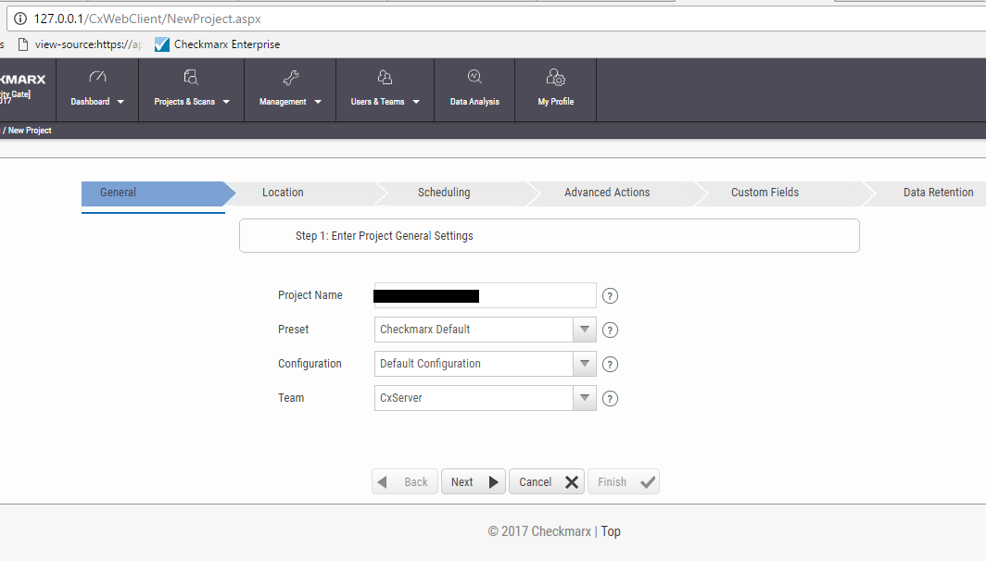

Slide 8
Performing a Local Scan

Slide 9
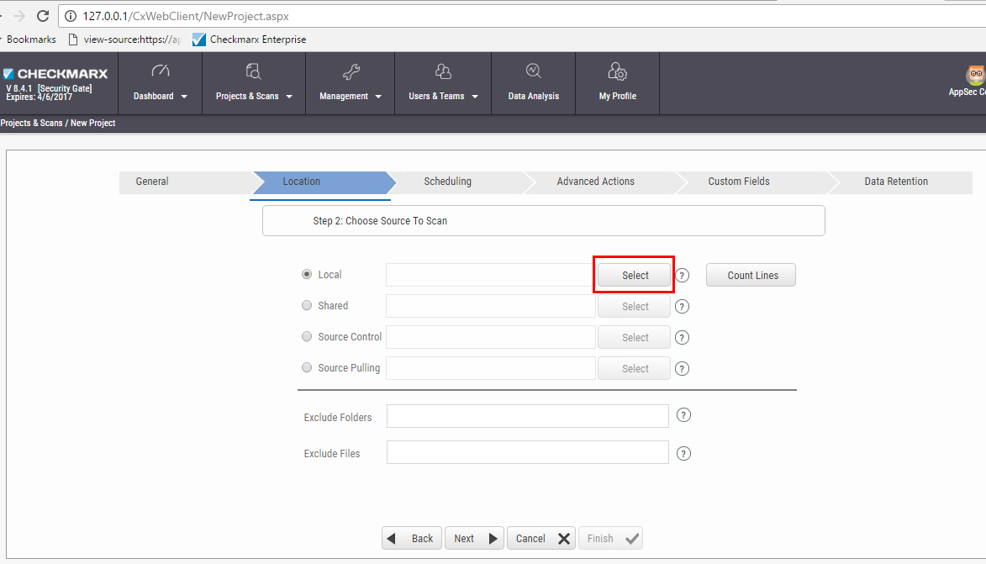
In the “Location” section, choose “Local” and click on “select” button

Slide 10
The local upload option allows only compressed file with “.zip” extension which is below 200 MB in size.

Slide 11
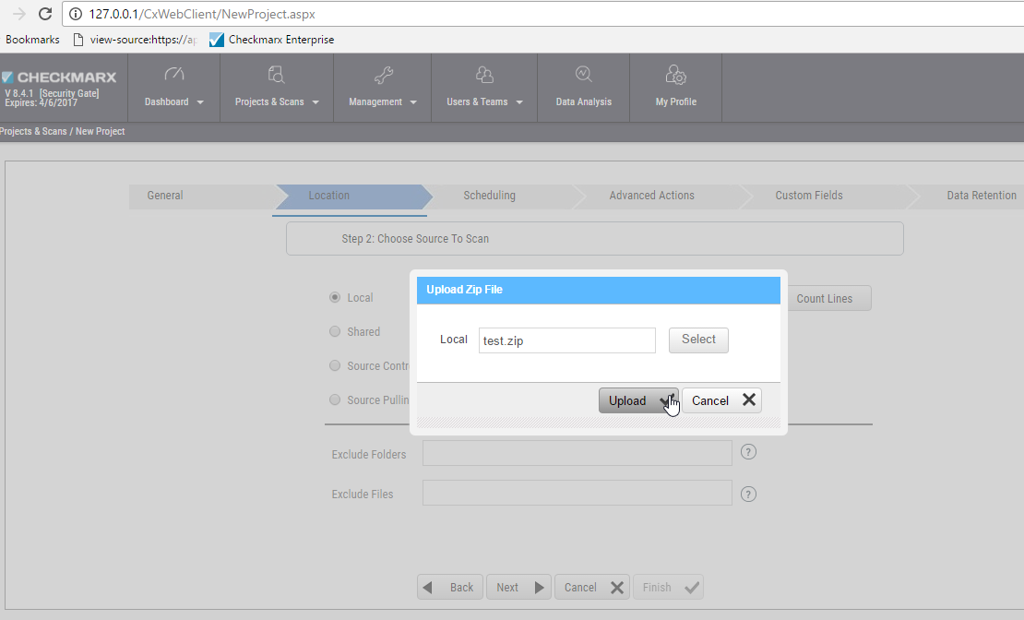
In the “Upload Zip File” pop-up, click on select and upload the compressed zip file(size below 200MB) and click on “Upload” button

Slide 12
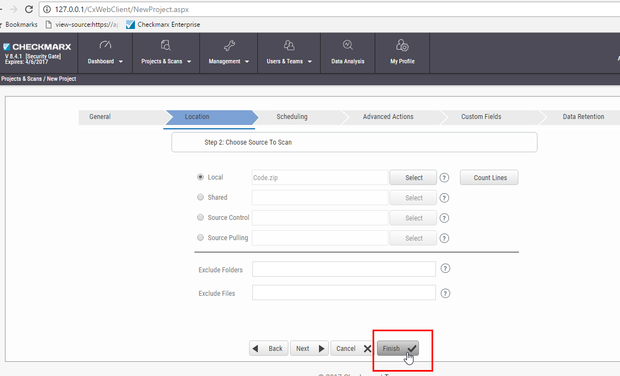
Click on “Finish” after the Uploading is complete and the scanning process will initiate.

Slide 13
Performing a Shared Scan

Slide 14
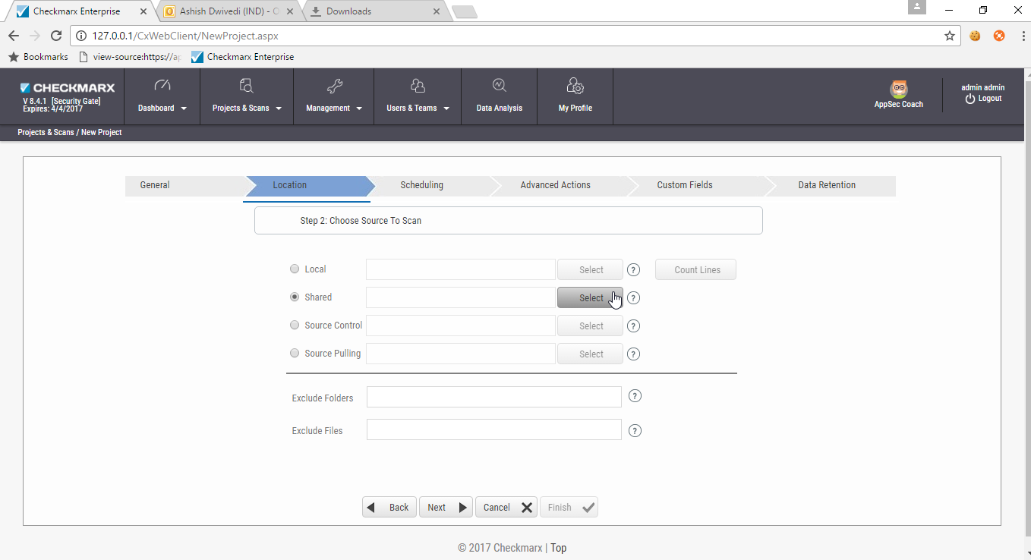
In the “Location” section, choose “Shared” and click on “select” button

Slide 15
If the compressed file with “.zip” extension which is above 200 MB in size, We have to make use of the “shared” option, where we upload the application’s source on a shared network and map the shared network in Checkmarx

Slide 16
Create a new user with admin rights and full access in the shared client. In this case we make use of the user “test” “Network Credentials” popup will appear, enter the following credentials: Username: .\test Password: asd@123

Slide 17
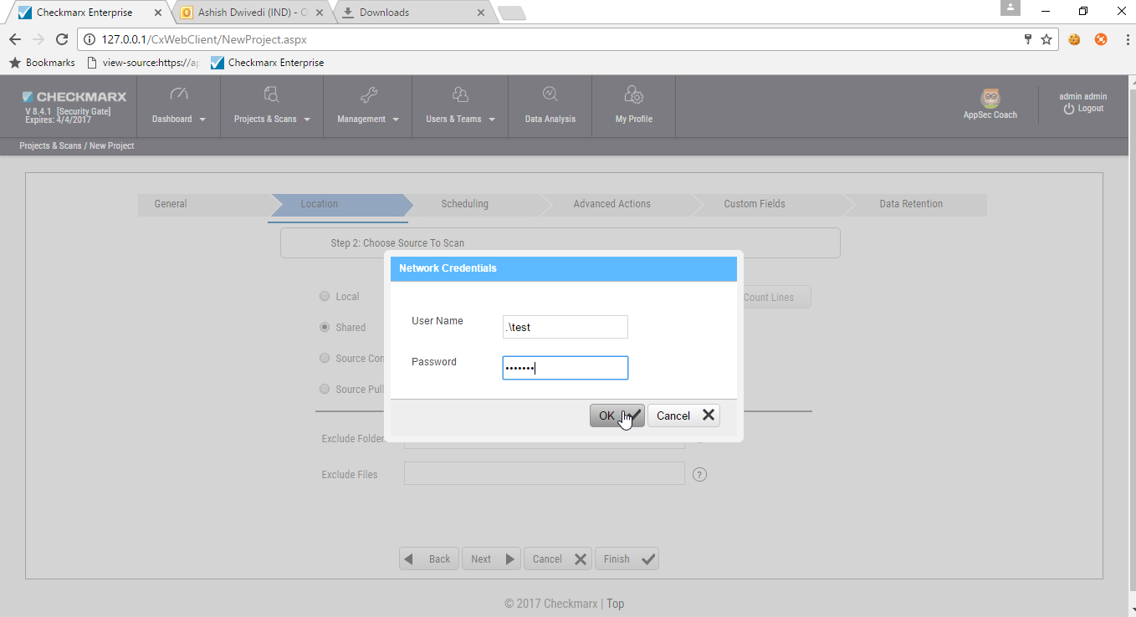

Slide 18
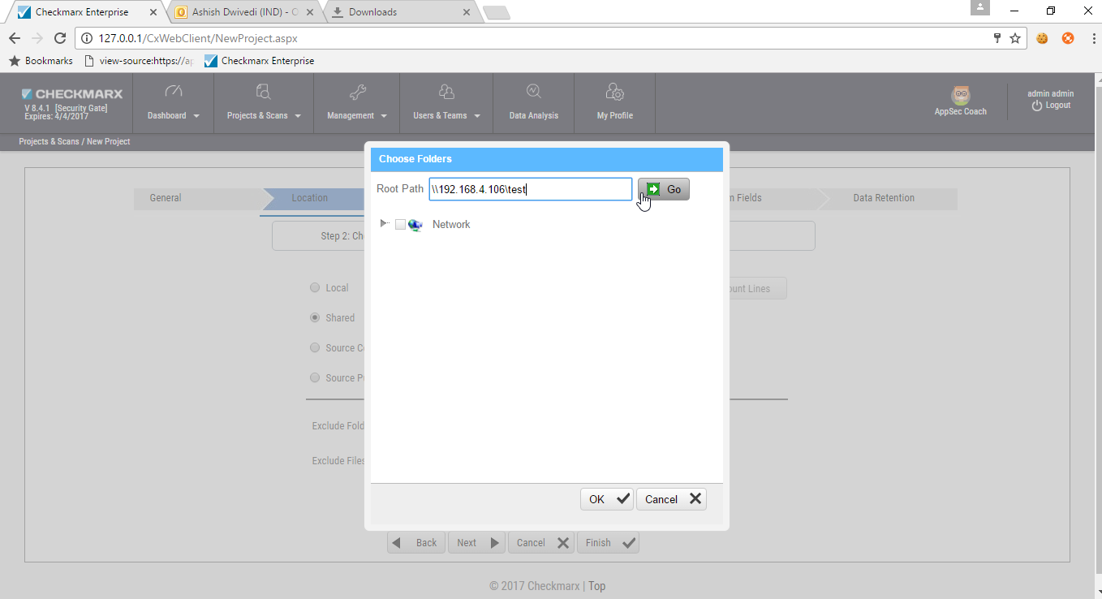
“Choose Folders” popup will appear, enter the shared drive path(\\192.168.4.106\test) in the Root Path field and click on “GO”

Slide 19
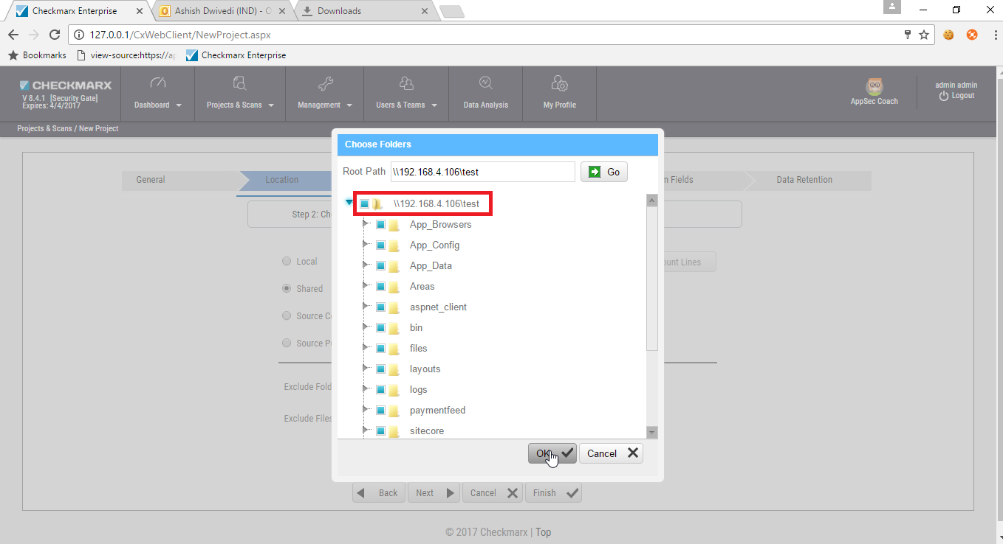
Shared folders list will be populated, select the folder which contains the source files and click on OK

Slide 20
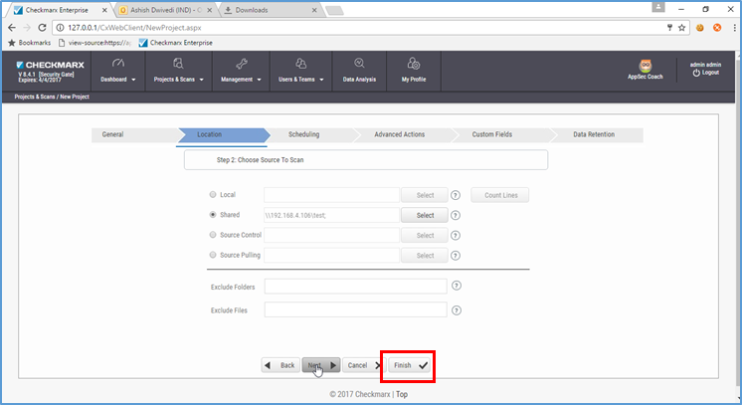
After the shared location has been mapped, click on Finish

Slide 21
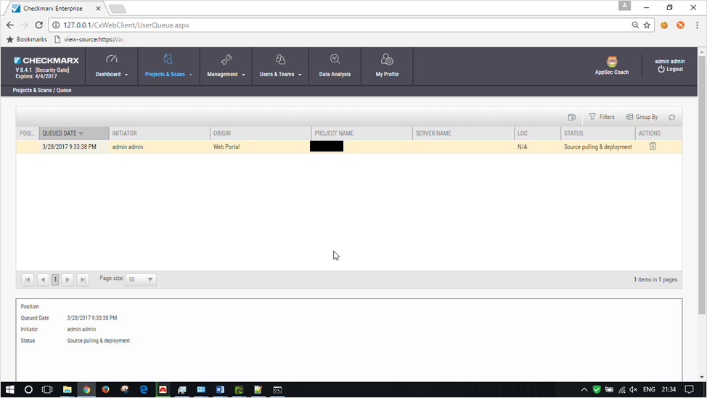
The scan will initiate

Slide 22
Performing an Android application’s Source Code Scan

Slide 23
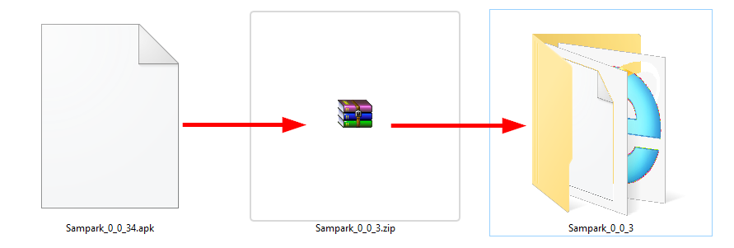
Testing the source of an Android app
Change the extension of the android file from “.apk” to “.zip” and extract the zip file

Slide 24
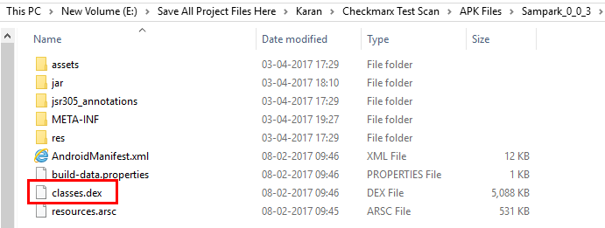
Retrieve the classes.dex file from the uncompressed folder

Slide 25
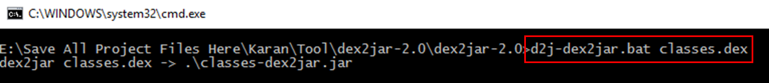
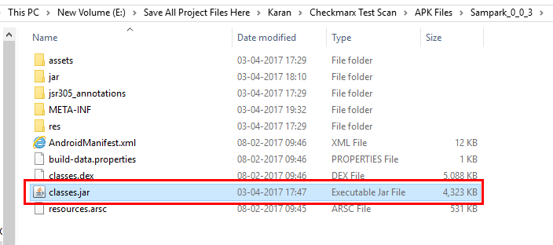
Convert the classes.dex file to classes.jar using the dex2jar utility

Slide 26
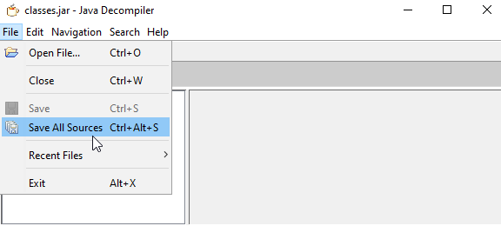
Open the classes.jar file in jd-gui(where classes in a jar file can be decompiled) and perform “Save All Sources” operation from the File menu

Slide 27
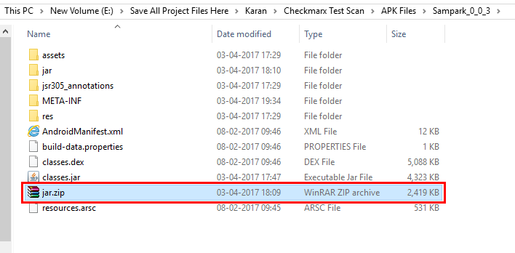
The save operation will create a zipped file containing the apk’s source code

Slide 28
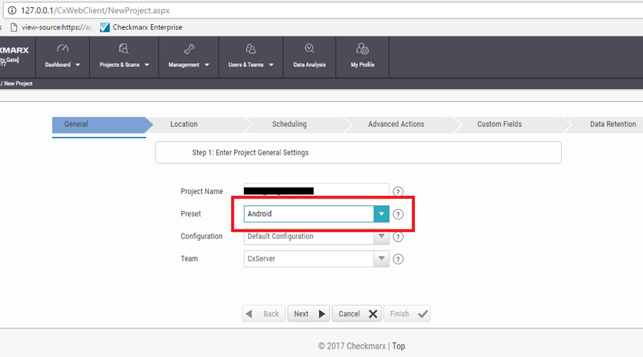
Perform a Local scan using checkmarx
Select “Android” for the Preset dropdown

Slide 29
Challenges faced while using Checkmarx

Slide 30
Challenge 1:
Passcode error appears while opening setup zip provided by Checkmarx support, hence we need to make sure if the passcode provided was correct.
Challenge 2:
We cannot upload source code above 200MB into the Checkmarx portal for scanning, we can follow the below ways to continue the scan:
Make use of Cx Zip utility available on the checkmarx website to decompress the source code.
We can host the source code over a local network and a run a shared scan (demonstrated above)
Challenge 3:
Checkmarx needs IIS for hosting its scanning services on the machine on which it will be hosted.
Challenge 4:
Checkmarx needs a minimum of 16GB RAM to execute source code scanning smoothly.

Slide 31
Challenge 5:
Checkmarx specific services needs to be started in the Windows services (services.msc) else the scans will not proceed.
Challenge 6:
Checkmarx by default supports only 20 lakh (2000000) lines of code per scan. If we have a requirement of more than 20 lakh lines, we need to get the license upgraded from the Checkmarx support which is free of cost.
Challenge 7:
Checkmarx does not allow more than 10 active scans at a time, so we need to keep taking consistent backups and releasing scans. (Note: Releasing scan will delete the scan, hence it is recommended to take multiple backups and generate the report in all the extensions before releasing)

